Slide 1
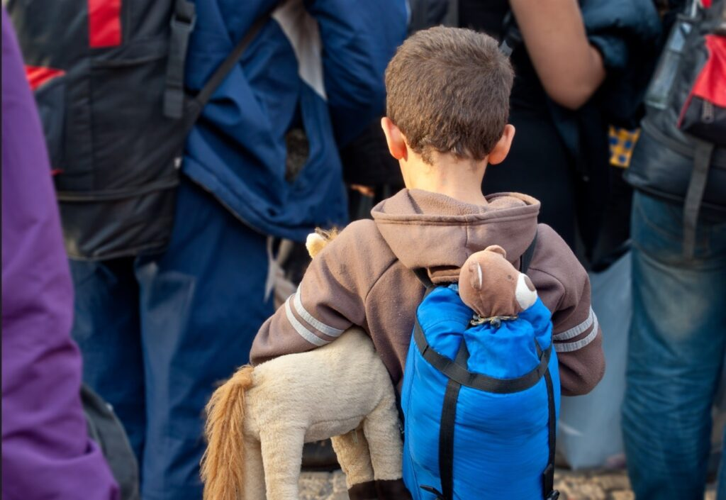
Child Migration 2022
by
Gian Romano

Slide 2

Child migration
Child migration or "children in migration or mobility" (sometimes more generally "children on the move") is the movement of people ages 0–17 within or across political borders, with or without their parents or a legal guardian, to another country or region.
The data we will be exploring comes from EUROSTAT and correspond only to european countries.

Slide 3

Last three years in the EU:
From 2021 to 2022
209%
521.282 in 2020
651.867 in 2021
1.363.365 in 2022

Slide 4



TOP 5 EU COUNTRIES in 2022
75%
Germany 520.930
of total
Spain 227.674
France 103.055
Czech Republic 91.337
Italy 75.936

Slide 5

By GROUP of AGE in 2022:
77%
17%
6%
17 - 18
82.521
14 - 17
229.962
Less than 14
1.050.882

Slide 6
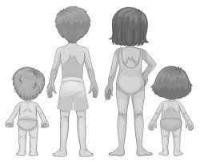
By GENDER:
52%
Girls
48%
Boys

Slide 7
PRE-CONCLUSIONS:
The level of complexity was barely touched.
Data about political asylum and resettled unaccompanied minors comes with one or two years of latency.
Further investigation will explain the nuances of this issue.

Slide 8
THANKS

